Slide 1

Recurrent neural network-based motion prediction method
2017.10.12
Advisor : Professor Park Kwang Hyun
Presenter : Kim Jong Gon

Slide 2
CONTENT
Robot Media Laboratory
1. Problem Suggestion
Prediction of Human motion
2. BackGround and Experiment
Recurrent Neural Networks(RNN)
RNN Encoder-Decoder Network
Sequence to Sequence(Seq2Seq) Network
Let’s apply it to motion
Problem Analysis
3. My suggestion and Result , Analysis
4. Learning Environment
5. Additional Usage
6. Future Research
7. Question and Answer
8. Appendix

Slide 3
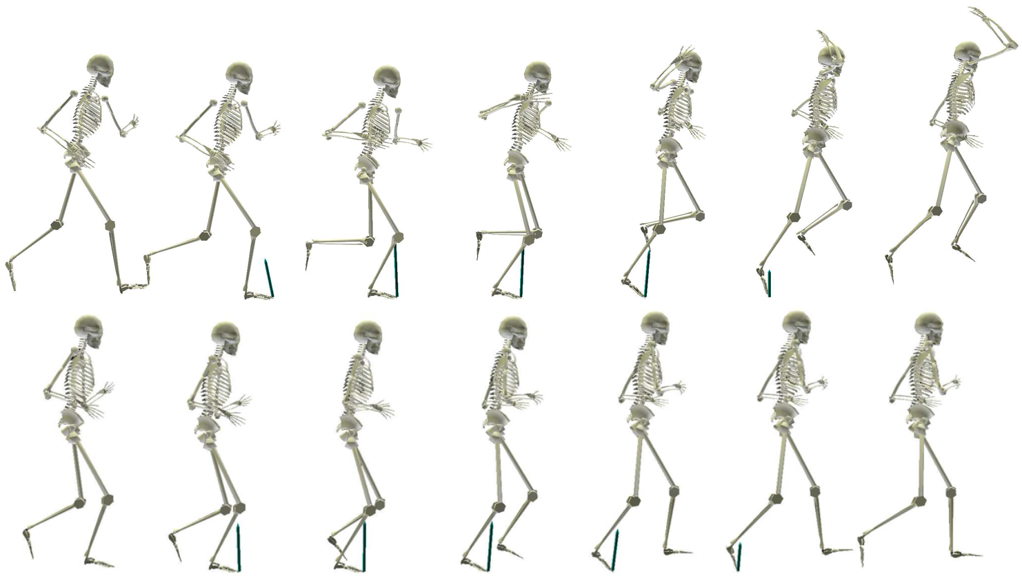
Problem Suggestion – Human Motion Analysis
Robot Media Laboratory
Generation of Human motion
Is it possible to generate the next motion with the previous motion information?

Slide 4
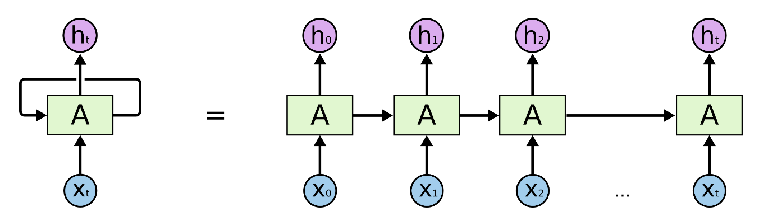
BackGround – Recurrent Neural Network
Robot Media Laboratory
<RNN Structure>
Notes:
RNN예 댸한 간딴 쏘꺠

Slide 5
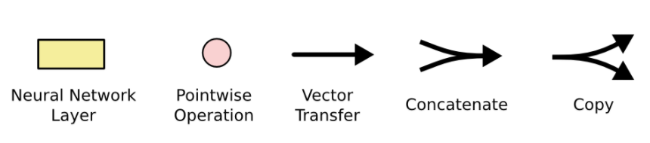
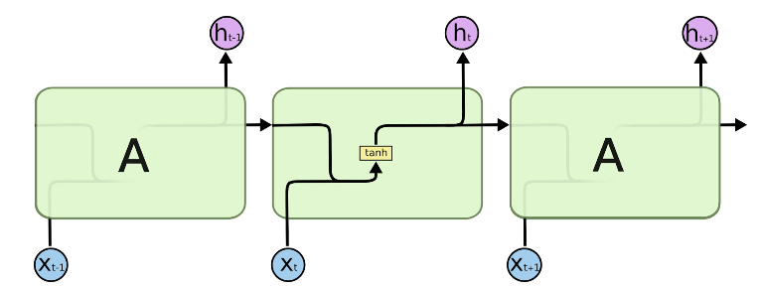
BackGround – Recurrent Neural Network
Robot Media Laboratory
<Inside of Basic RNN>
Notes:
RNN예 댸한 간딴 쏘꺠

Slide 6
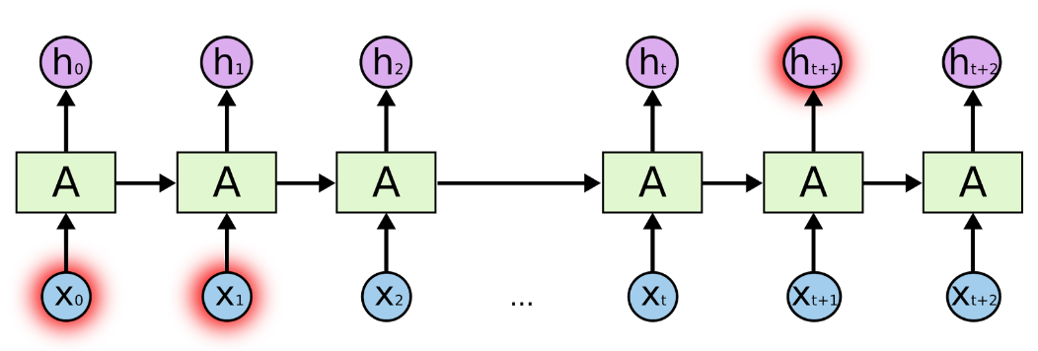
BackGround – Recurrent Neural Network
Robot Media Laboratory
<Short-Length RNN>
<The Problem of Long-Term Dependencies>
Notes:
RNN 에는

Slide 7
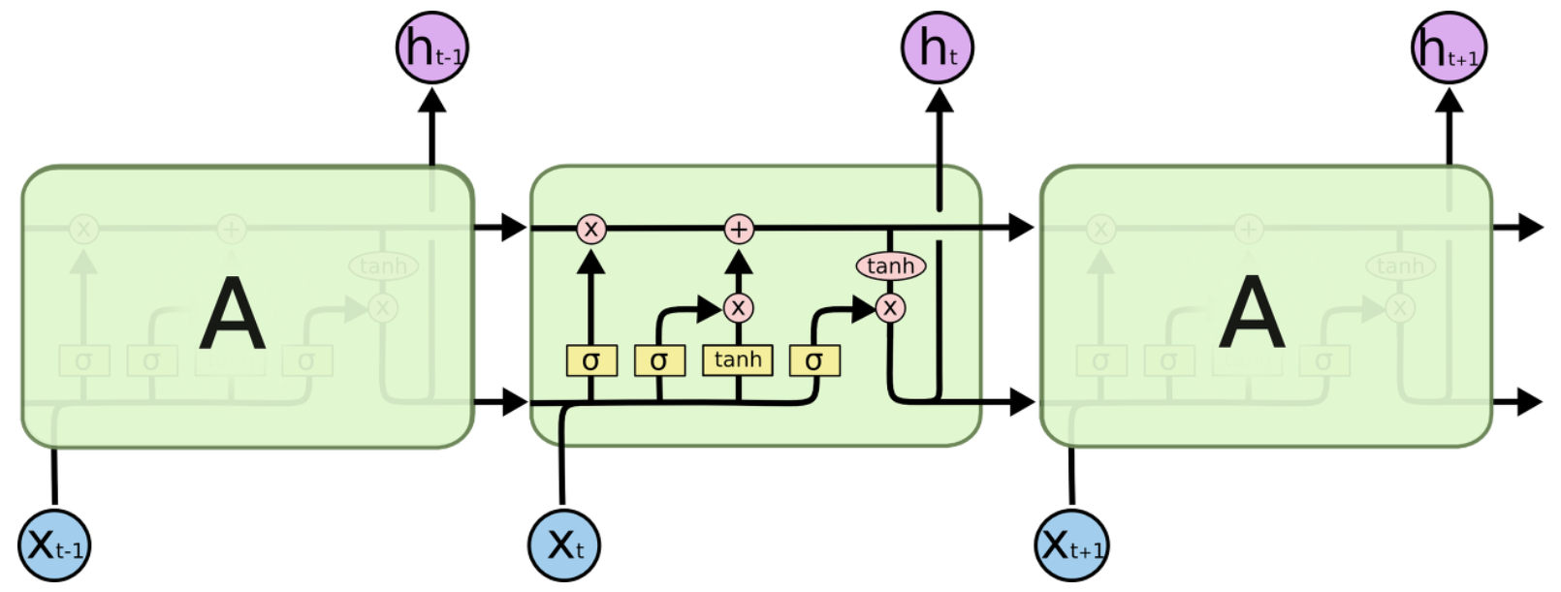
BackGround – Long Short Term Memory
Robot Media Laboratory
<Inside of Basic LSTM>
Notes:
RNN 에는

Slide 8
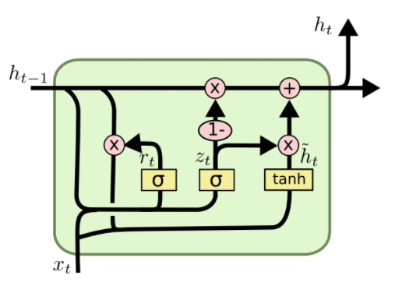
BackGround – Gated Recurrent Unit
Robot Media Laboratory
<Inside of Basic GRU>
Notes:
RNN 에는

Slide 9

BackGround – Various Structures Using RNN
Robot Media Laboratory
Notes:
one to one : 가장 기본적인 RNN으로 Vanilla RNN 이라고도 함.
one to many : image captioning(이미지를 입력으로 주면 문장이 출력)처럼 출력이 연속적인 데이터.
many to one : sentimental analysis(영화 리뷰가 긍정적인지 부정적인지 출력)처럼 입력이 연속적인 데이터.
many to many(not synced) : 기계번역, 챗봇 등과 같이 입력과 출력이 모두 연속적인 데이터.
many to many(synced) : video classification(각 프레임을 입력으로 받아 설명을 동시에 출력)처럼 입력과 출력이 모두 연속적인 데이터.

Slide 10
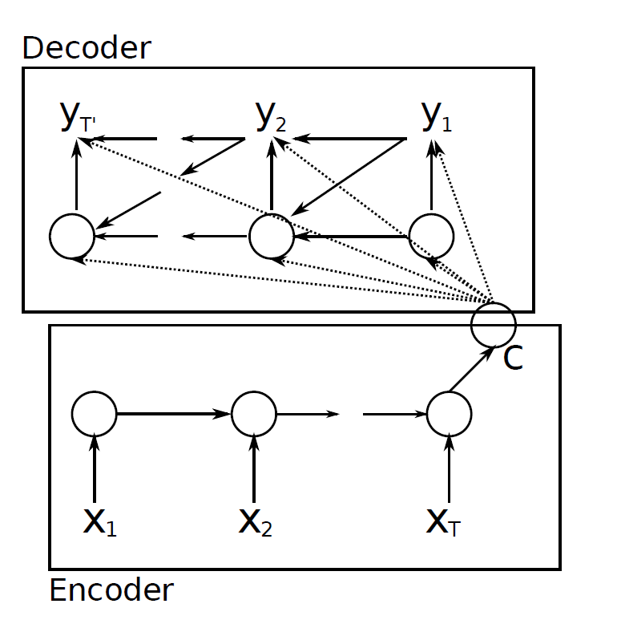
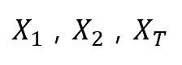
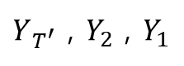
BackGround – RNN Encoder-Decoder Network
Robot Media Laboratory
$Y_{T^{′}}$ , $Y_{2}$ , $Y_{1}$
C : Context
Sequence Data
$X_{1}$ , $X_{2}$ , $X_{T}$
Usually Used for Language Translation

Slide 11
BackGround – Sequence to Sequence
Robot Media Laboratory
좋은
아침
C
O
N
T
E
X
T
LSTM/GRU
LSTM/GRU
LSTM/GRU
LSTM/GRU
Good
morning
<start>
좋은
encoder
decoder
<Seq2Seq Training Process>
Notes:
RNN을 활용한 여러가지것
One to one 기본구조
One to many 사진 - 단어
Many to one 분류
Many to Many 번역

Slide 12
BackGround – Sequence to Sequence
Robot Media Laboratory
좋은
아침
C
O
N
T
E
X
T
LSTM/GRU
LSTM/GRU
LSTM/GRU
LSTM/GRU
Good
morning
<start>
encoder
decoder
<Seq2Seq Test Process>

Slide 13
Suggestion1

Slide 14
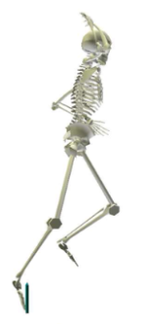
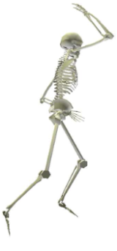
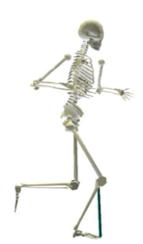
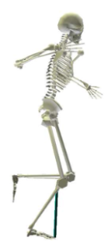
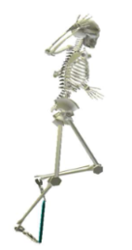
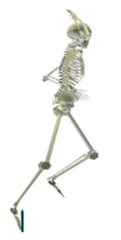
Let’s apply it to motion
Robot Media Laboratory
Training Process
LSTM/GRU = 1000
Linear = 72
30Frame
60Frame
C
O
N
T
E
X
T
Linear
Linear
Linear
Linear
LSTM/GRU
LSTM/GRU
LSTM/GRU
LSTM/GRU
+
+
+
+
Noise
Noise
Noise
Noise
Notes:
Dataset에 대한 설명 반드시 하기

Slide 15
Let’s apply it to motion
Robot Media Laboratory
Test Process
LSTM/GRU = 1000
Linear = 72
30Frame
60Frame
C
O
N
T
E
X
T
Linear
Linear
Linear
Linear
Linear
LSTM/GRU
LSTM/GRU
LSTM/GRU
LSTM/GRU
Notes:
RNN을 활용한 여러가지것
One to one 기본구조
One to many 사진 - 단어
Many to one 분류
Many to Many 번역

Slide 16
Let’s apply it to motion - Result
Robot Media Laboratory
100000 Epoch
Training Process
Joint angle Error :
Test Process
Joint angle Error :
Notes:
영상꼭넣기

Slide 17
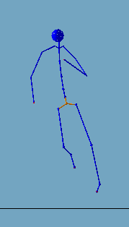
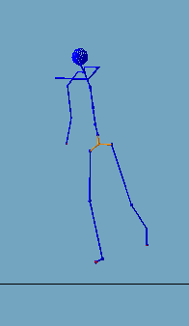
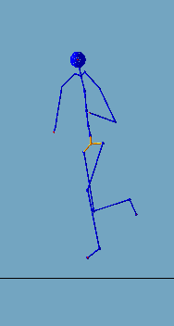
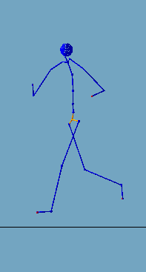
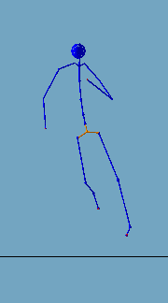
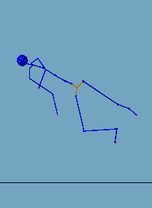
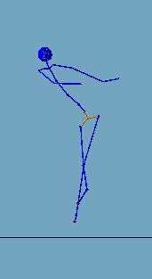
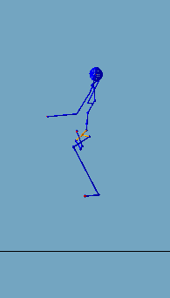
Let’s apply it to motion - Result
Robot Media Laboratory
30-Frame
40-Frame
60-Frame
90-Frame
Notes:
영상꼭넣기

Slide 18
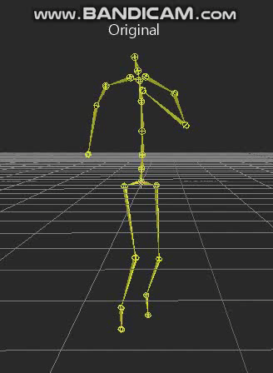
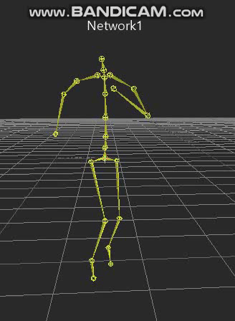
Let’s apply it to motion - Result
Robot Media Laboratory
Notes:
영상꼭넣기

Slide 19
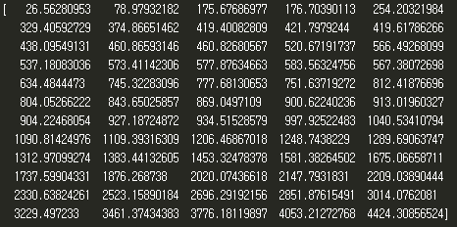
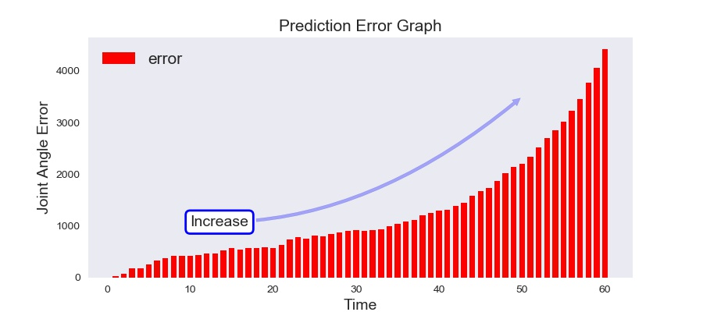
Let’s apply it to motion - Problem Analysis
Robot Media Laboratory
Cause Analysis
1. It seems that the test method and the training method are different.
2. Actual data. It is not 'one hot encoding' data.
Error Analysis
Notes:
RNN을 활용한 여러가지것
One to one 기본구조
One to many 사진 - 단어
Many to one 분류
Many to Many 번역

Slide 20
Suggestion2

Slide 21
My Suggestion
Robot Media Laboratory
Training Process
LSTM/GRU = 1000
Linear = 72
30Frame
60Frame
C
O
N
T
E
X
T
Linear
Linear
Linear
Linear
LSTM/GRU
LSTM/GRU
LSTM/GRU
LSTM/GRU
+
+
+
Noise
Noise
Noise
Notes:
RNN을 활용한 여러가지것
One to one 기본구조
One to many 사진 - 단어
Many to one 분류
Many to Many 번역

Slide 22
My Suggestion
Robot Media Laboratory
Test Process
LSTM/GRU = 1000
Linear = 72
30Frame
60Frame
C
O
N
T
E
X
T
Linear
Linear
Linear
Linear
Linear
LSTM/GRU
LSTM/GRU
LSTM/GRU
LSTM/GRU
Notes:
RNN을 활용한 여러가지것
One to one 기본구조
One to many 사진 - 단어
Many to one 분류
Many to Many 번역

Slide 23
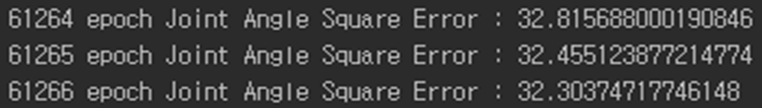
My Suggestion - Result and Problem Analysis
Robot Media Laboratory
Training Process
Joint angle Error
It does not converge = Learning does not work.
cause analysis
It seems that it does not contain all the information.
solution
Let's change the structure of the network
Notes:
Training dataset에서 조차 수렴이 되지 않았다.

Slide 24
Suggestion3

Slide 25

My Suggestion
Robot Media Laboratory
Training Process
LSTM/GRU = 1000
Linear1, 2,..,N = Not sharing
Linear = 72
Linear(N) = 72X2
30Frame
60Frame
C
O
N
T
E
X
T
Linear
Linear
Linear
Linear
LSTM/GRU
LSTM/GRU
Linear1
Linear2
LSTM/GRU
LSTM/GRU
Parameter
Sharing
+
+
+
Noise
Noise
Noise

Slide 26
My Suggestion
Robot Media Laboratory
Test Process
LSTM/GRU = 1000
Linear1,..,N = Not sharing
Linear = 72
Linear(N) = 72X2
30Frame
60Frame
C
O
N
T
E
X
T
Linear
Linear
Linear
Linear
LSTM/GRU
LSTM/GRU
Linear1
Linear2
LSTM/GRU
LSTM/GRU
Parameter
Sharing

Slide 27
My Suggestion - Result
Robot Media Laboratory
100000 Epoch
Training Process
Joint angle Error :
Test Process
Joint angle Error :

Slide 28
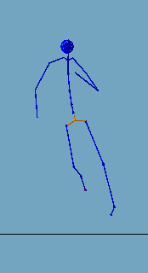
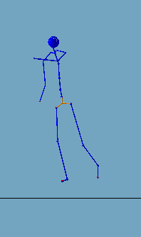
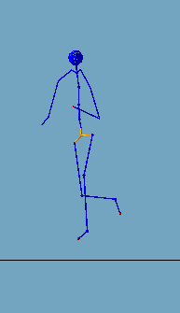
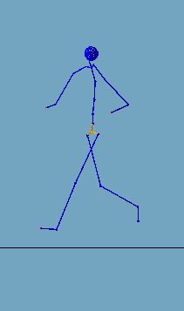
My Suggestion - Result
Robot Media Laboratory
30-Frame
40-Frame
60-Frame
90-Frame

Slide 29
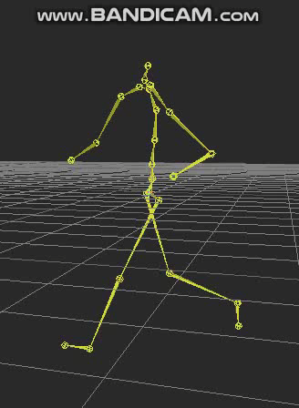
My Suggestion - Result
Robot Media Laboratory

Slide 30
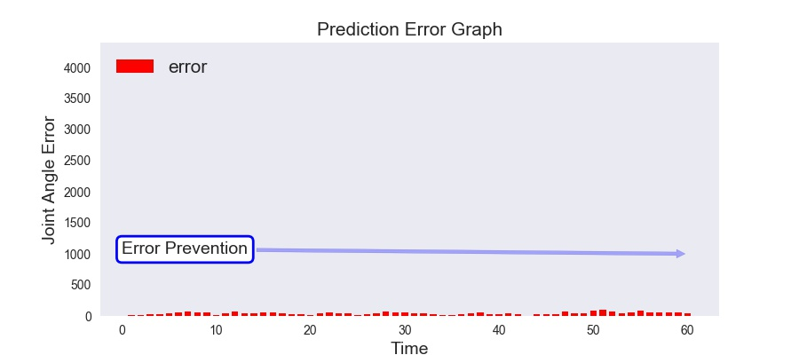
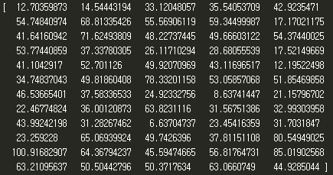
My Suggestion - Solution Analysis
Robot Media Laboratory
Error Analysis
Linear
Linear2
LSTM/GRU
Linear
: Role to prevent error accumulation

Slide 31
Learning Environment
Robot Media Laboratory
Dataset
Training Data : The training motion data (816) for 8 men and 4 women,
68 motion data per person.
Test Data : The Test motion data (204) for 2 men and 1 women,
68 motion data per person.
Learning Hyperparamter
Using GTX1070 : about 20 hours
Adam optimizer : Learning rate = 0.0001
Batch size = 68
Initialization : Normal Distribution(mean=0 , standard Deviation=0.01)
LSTM Layer = 1
LSTM Cell = 1000
Encoder : 30 Time Step , Decoder : 60 Time Step

Slide 32
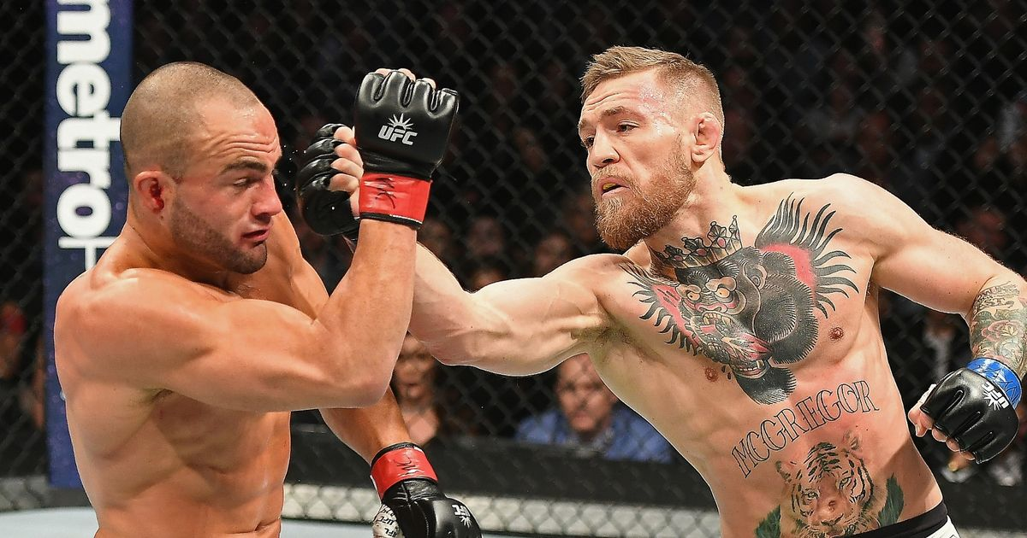
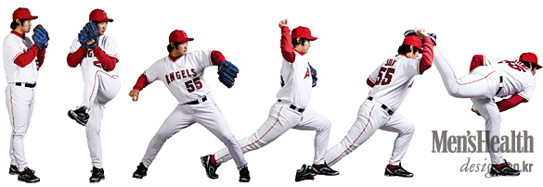
Additional Usage
Robot Media Laboratory
Notes:
물체변형 성능 향상을 위한 u-net and reu 기반의 c 생성신경망 구조 개선
인강행동예측을 위한 Recurrent Neural Network 기반의 변형된 Sequence to Sequence구조제안

Slide 33
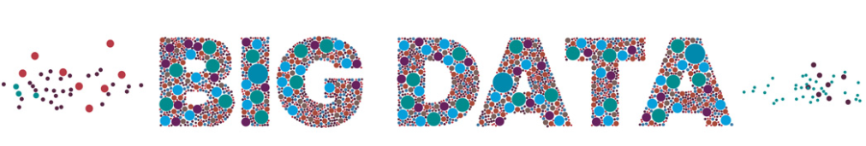
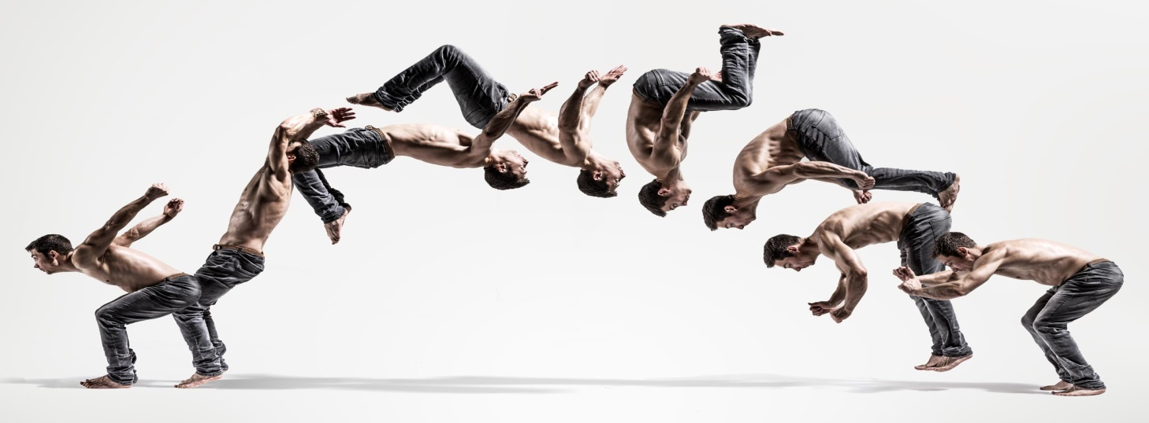
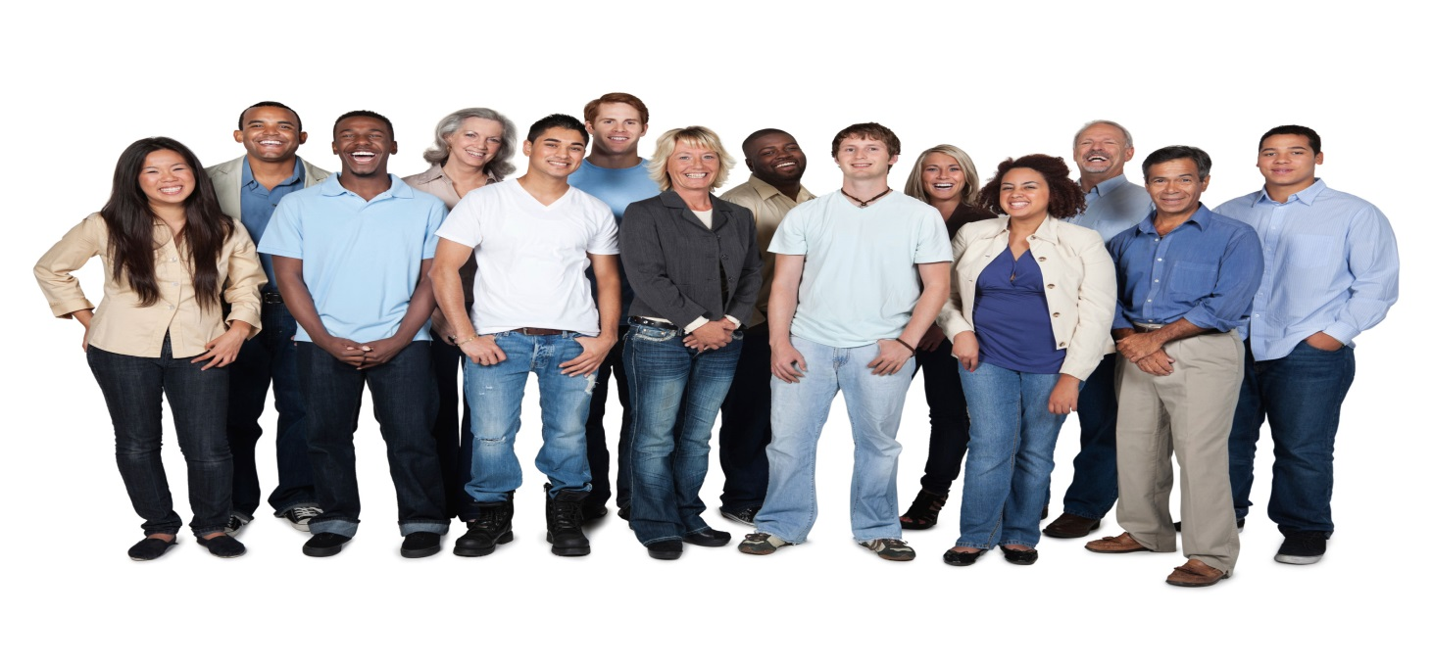
Future Research
Robot Media Laboratory
Notes:
더 다양한 동작 , 더 많은 사람의 데이터를 만들기

Slide 34
Q / A
https://github.com/JONGGON/DeepHumanPrediction

Slide 35
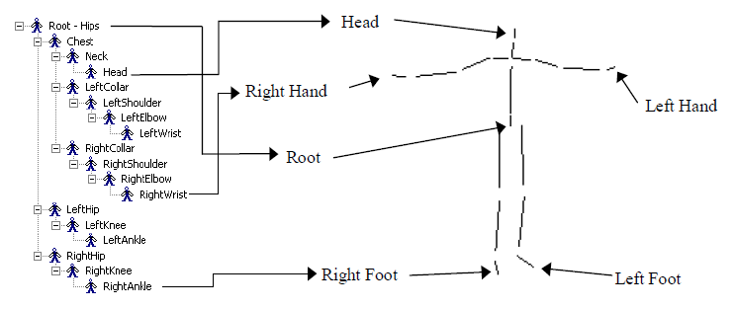
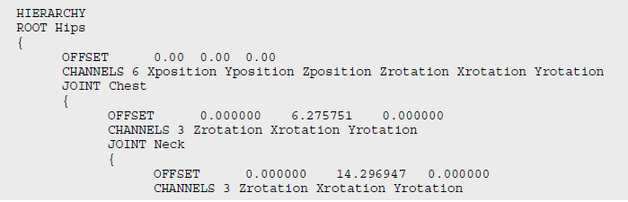
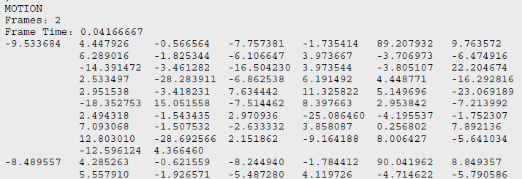
Appendix1-1
Robot Media Laboratory
Skeletal motion files created by attaching the C3D data to a BVH format skeleton in MotionBuilder. The BVH file defines both the skeleton and the motion data all in one file.

Slide 36
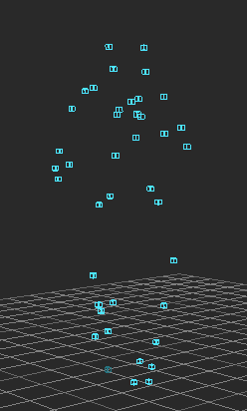
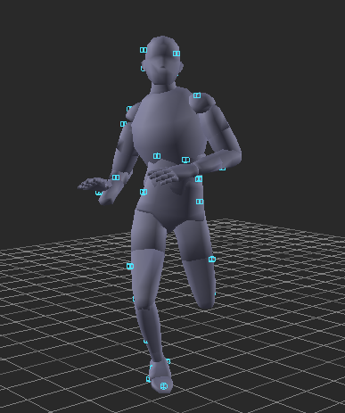
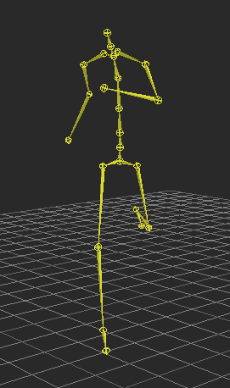
Appendix1-2
Robot Media Laboratory
Reconstructed 3D data from the Vicon Workstation or iQ. Can be used in MotionBuilder, Maya or any 3D program to drive skeletal or other data.

Slide 37
Thank you

